Slide 1
Maharaja Agrasen Institute of Technology ETCS 211 Computer Graphics & Multimedia UNIT 1
3D TRANSFORMATIONS

Slide 2
2D Transformations

Slide 3
Transformation
Transform every point on an object according to certain rule.
Q (x’, y’)
P (x,y)
T
Initial Object
Transformed Object
x x’
y y’
The point Q is the image of P under the transformation T.

Slide 4
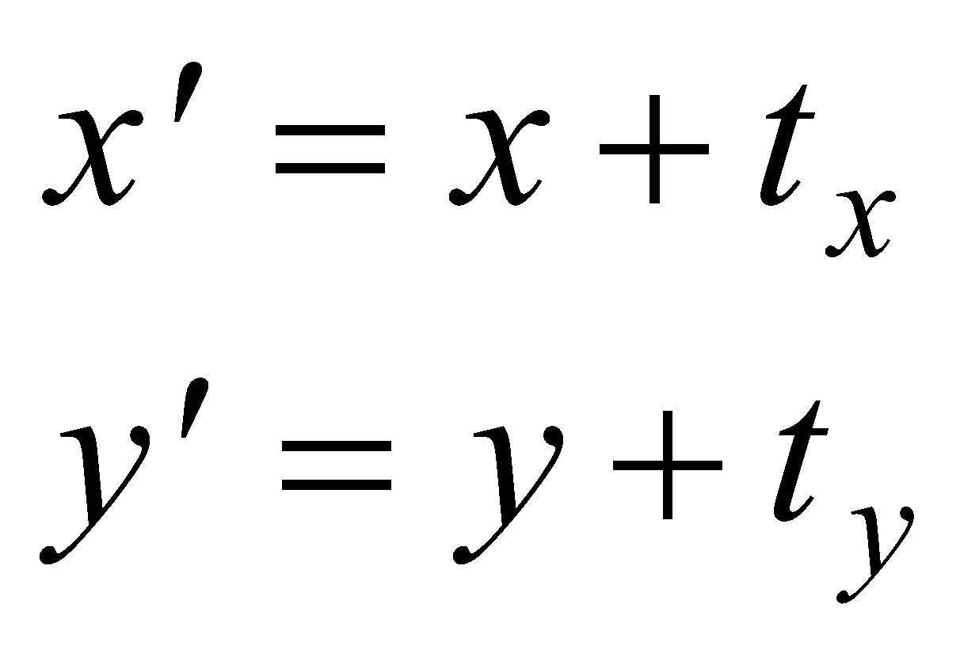
Translation
(55,60)
(20,35)
(45,30)
(65,30)
(10,5)
(30,5)
The vector (t_{x}, t_{y}) is called the offset vector.

Slide 5
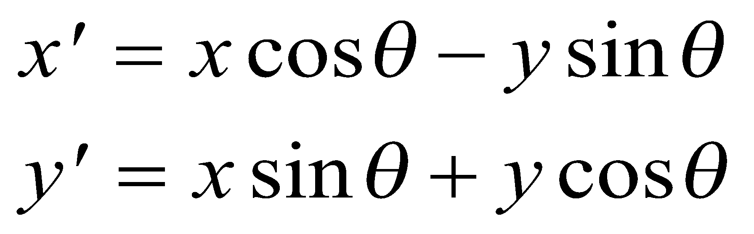
Rotation About the Origin
y
(x’,y’)
(x’,y’)
(x,y)
(x,y)
θ
o
x
The above 2D rotation is actually a rotation about the z-axis (0,0,1) by an angle θ.

Slide 6
Rotation About a Pivot Point
(x’,y’)
(x,y)
(x_{p} , y_{p})
Pivot Point
Pivot point is the point of rotation
Pivot point need not necessarily be on the object

Slide 7
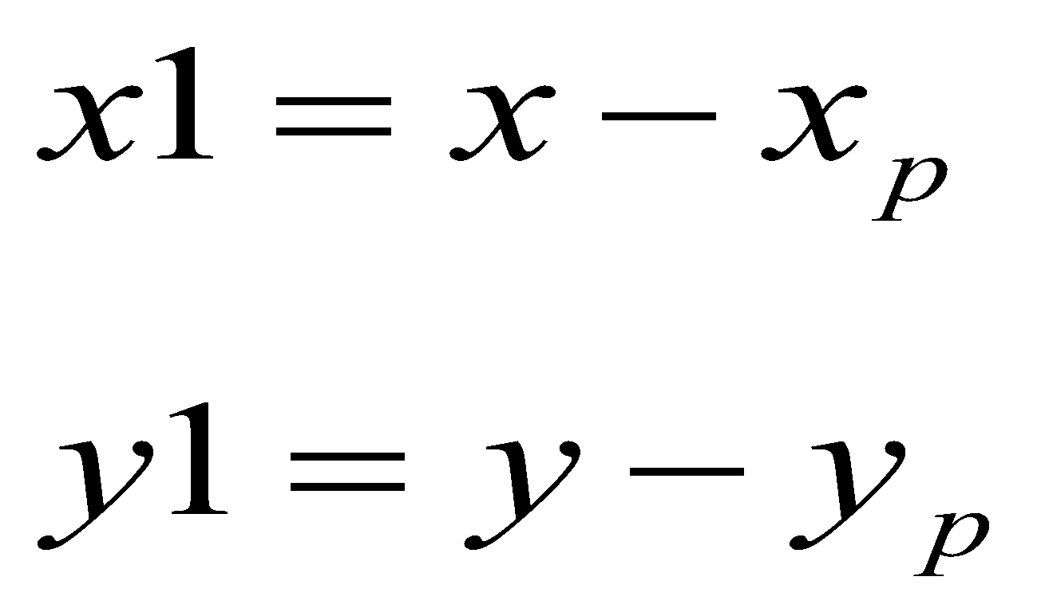
Rotation About a Pivot Point
STEP-1: Translate the pivot point to the origin
(x,y)
(x1, y1)
(x_{p} , y_{p})

Slide 8
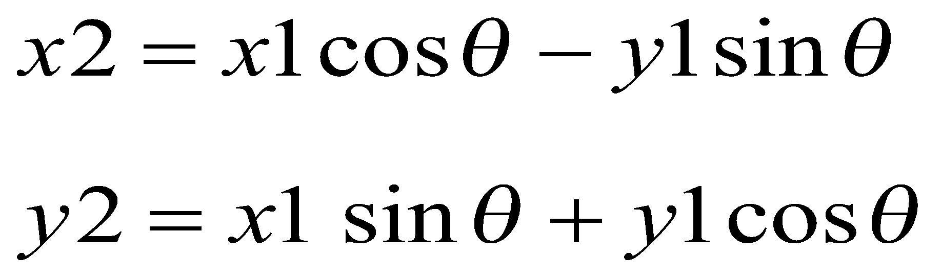
Rotation About a Pivot Point
STEP-2: Rotate about the origin
(x2, y2)
(x1, y1)

Slide 9
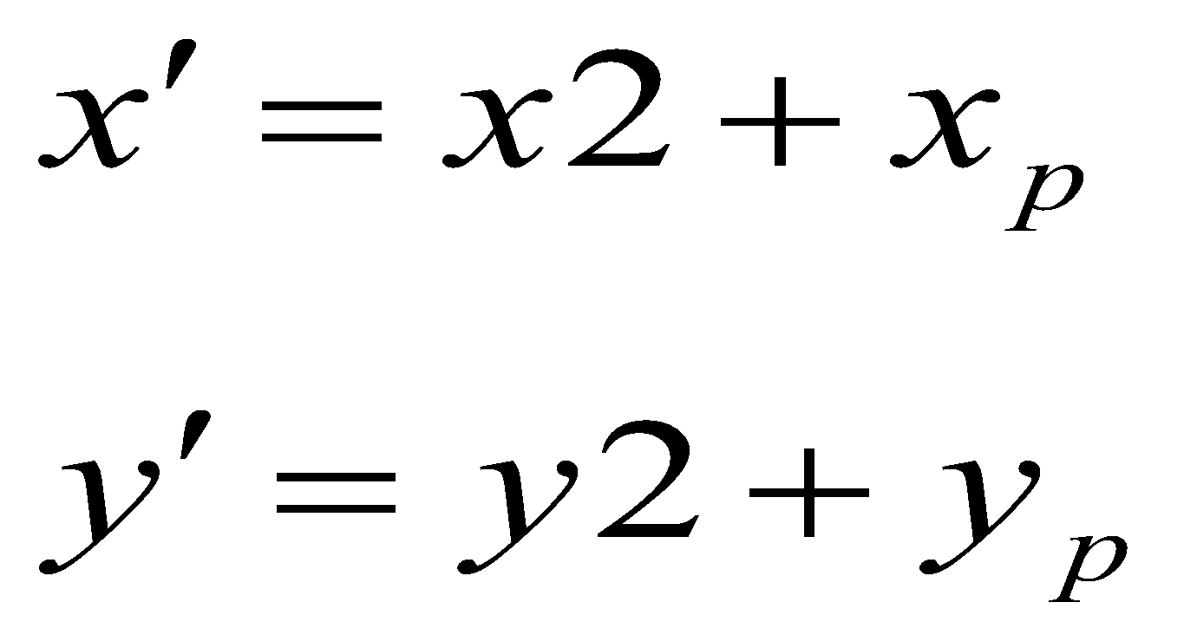
Rotation About a Pivot Point
STEP-3: Translate the pivot point to original position
(x’, y’)
(x2, y2)
(x_{p}, y_{p})

Slide 10
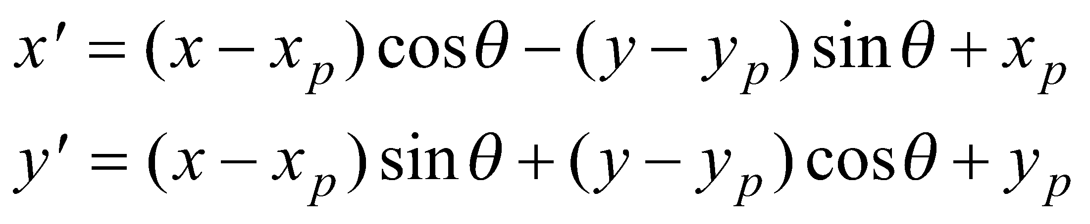
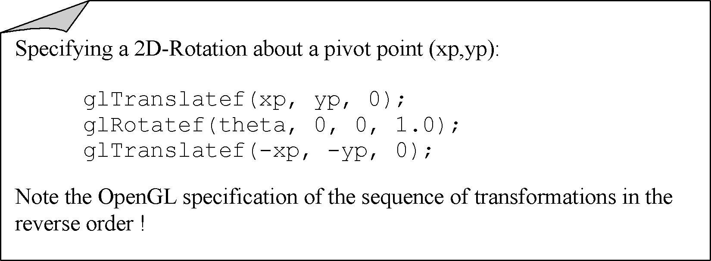
Rotation About a Pivot Point

Slide 11
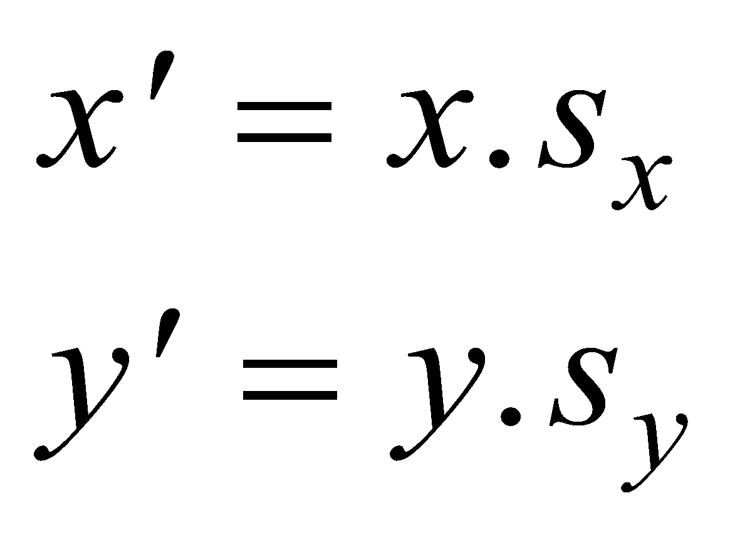
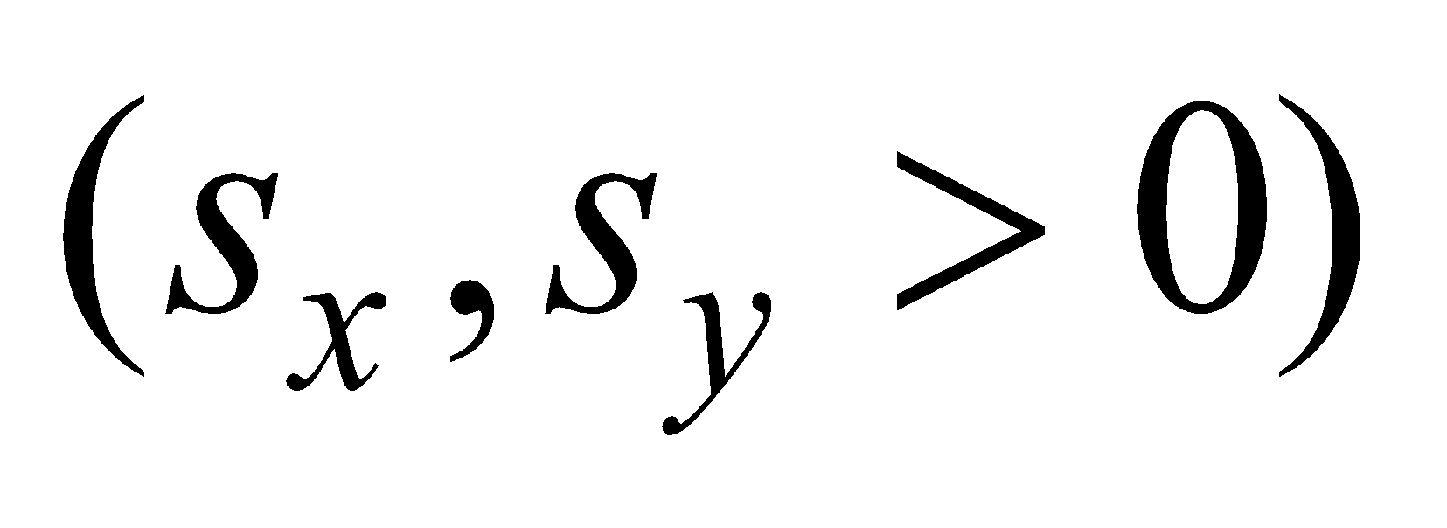
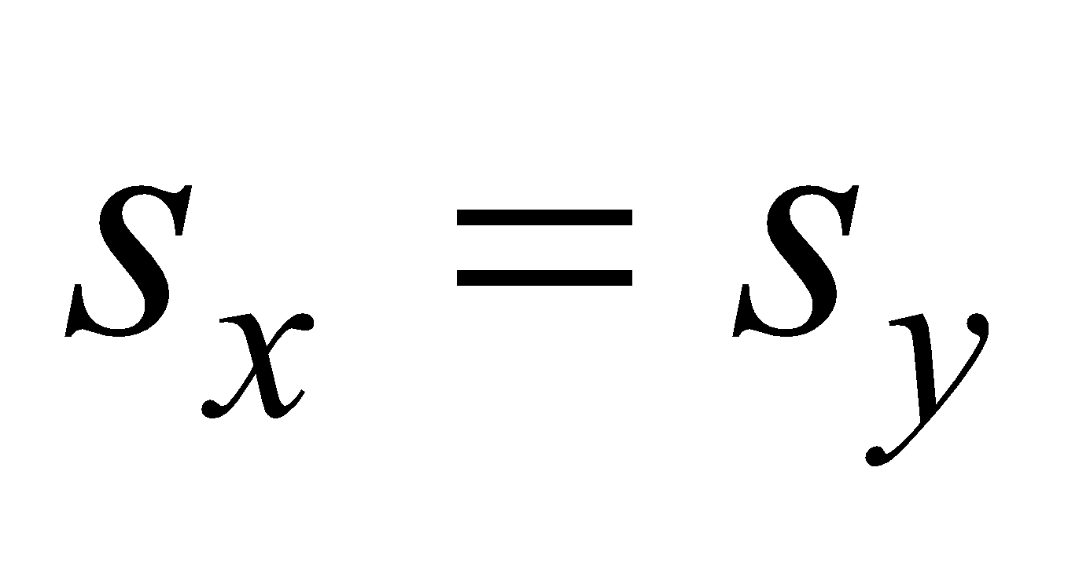
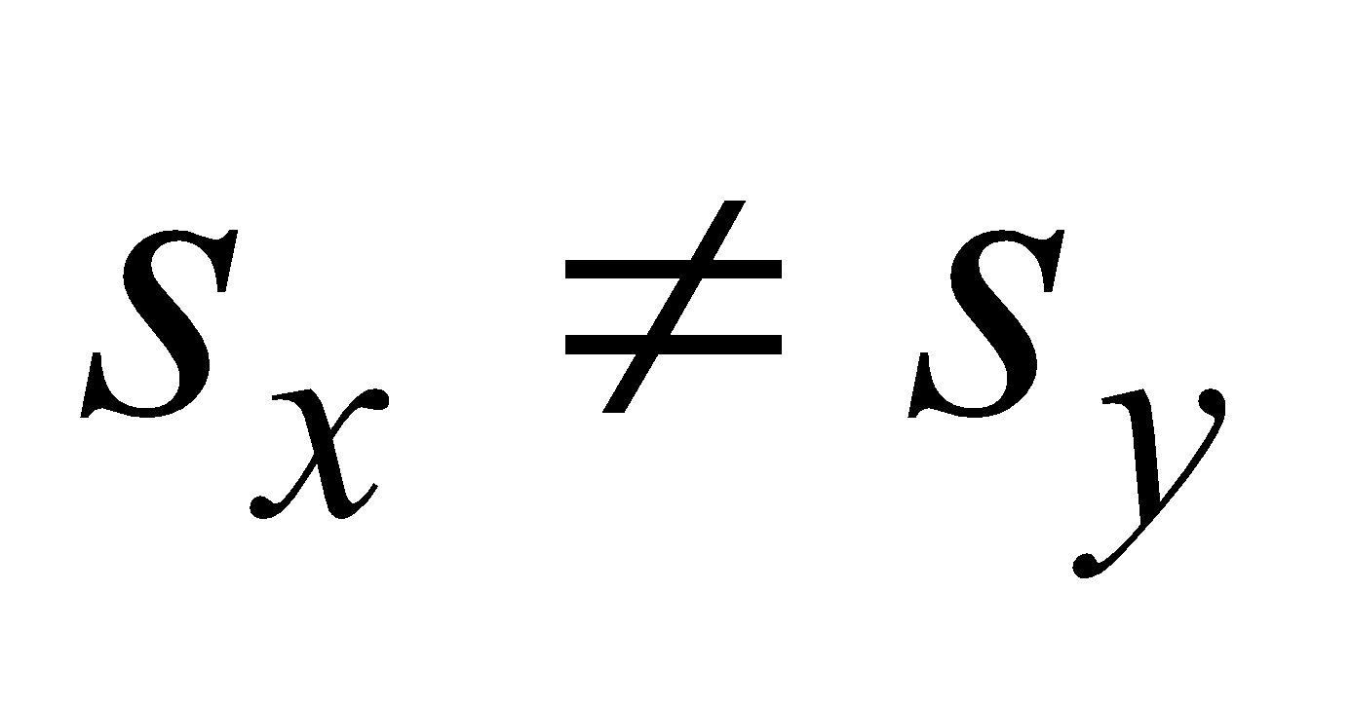
Scaling About the Origin
(x’,y’)
(x,y)
(x,y)
(x’,y’)
Uniform
Non-Uniform
The parameters s_{x}, s_{y} are called scale factors.

Slide 12
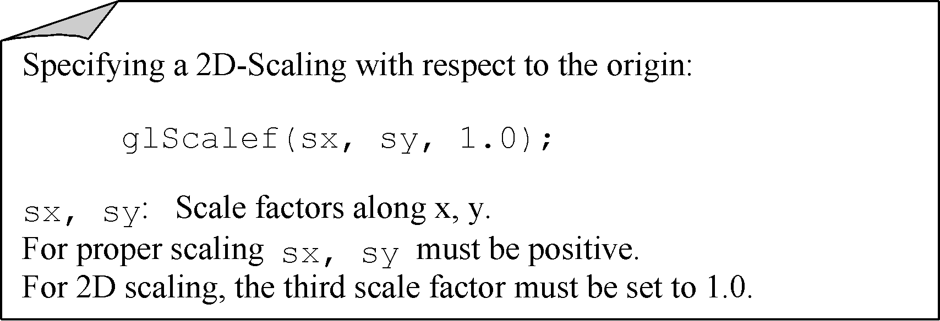
Scaling About the Origin

Slide 13
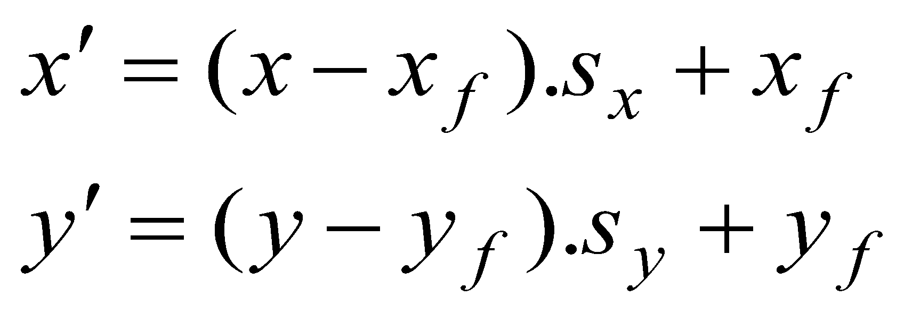
Scaling About a Fixed Point
Translate the fixed point to origin
Scale with respect to the origin
Translate the fixed point to its original
position.
(x,y)
(x’,y’)
(x_{f} , y_{f} )

Slide 14
Reflections
y
Reflection about y
x′ = − x
Initial
Object
x
Reflection about
origin
x′ = − x
y′ = − y
Reflection about x
y′ = − y

Slide 15
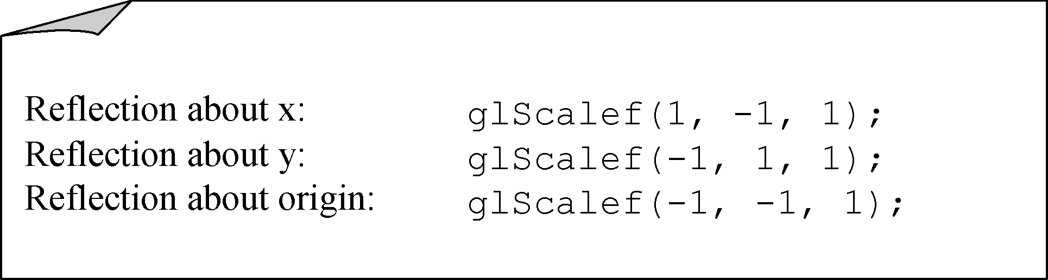
Reflections

Slide 16
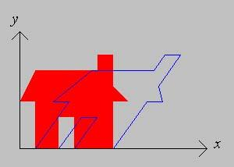
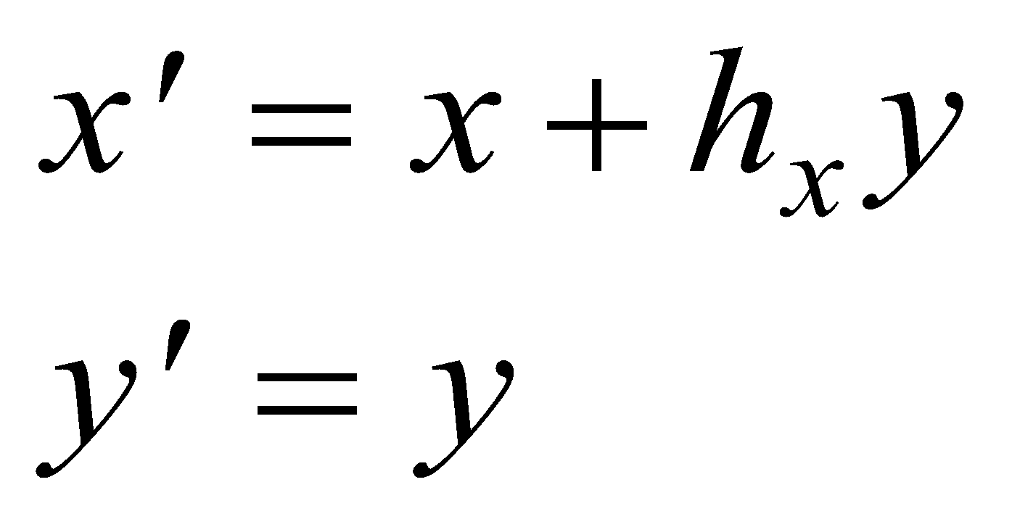
Shear
A shear transformation in the x-direction (along x)
shifts the points in the x-direction proportional
to the y-coordinate.
The y-coordinate of each point is unaffected.

Slide 17
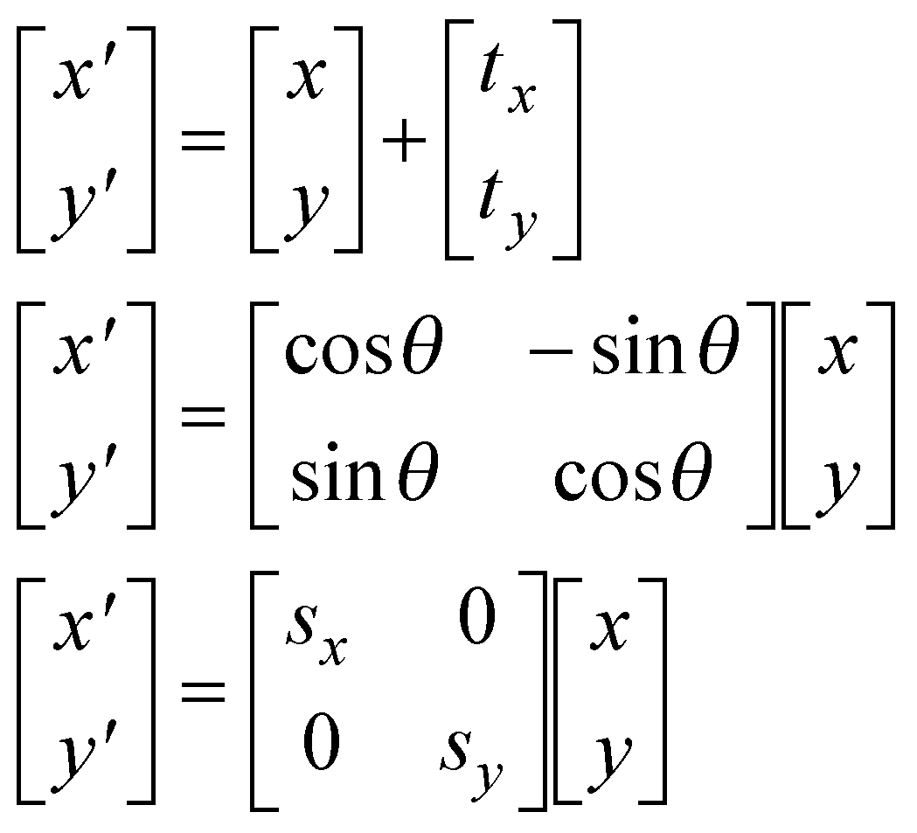
Matrix Representations
Translation
Rotation [Origin]
Scaling [Origin]

Slide 18
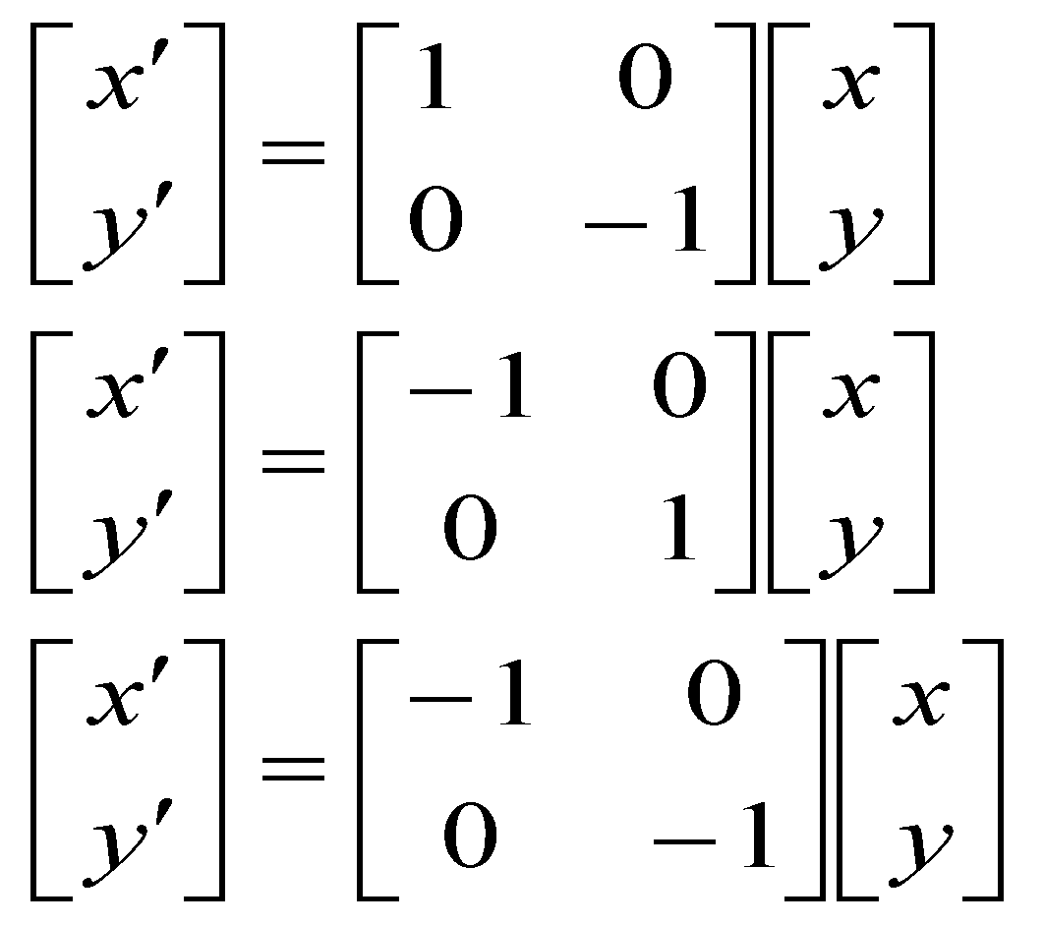
Matrix Representations
Reflection about x
Reflection about y
Reflection about
the Origin

Slide 19
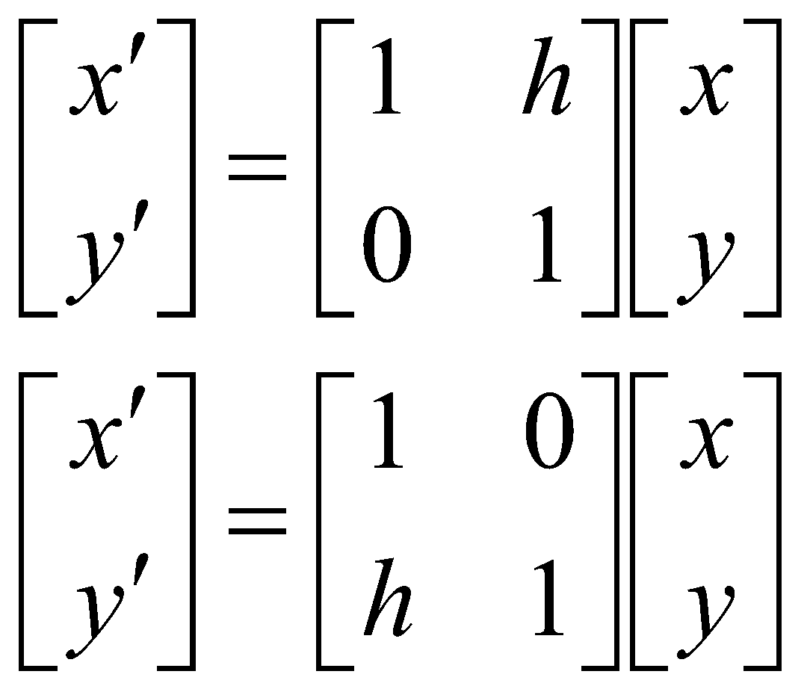
Matrix Representations
Shear along x
Shear along y

Slide 20
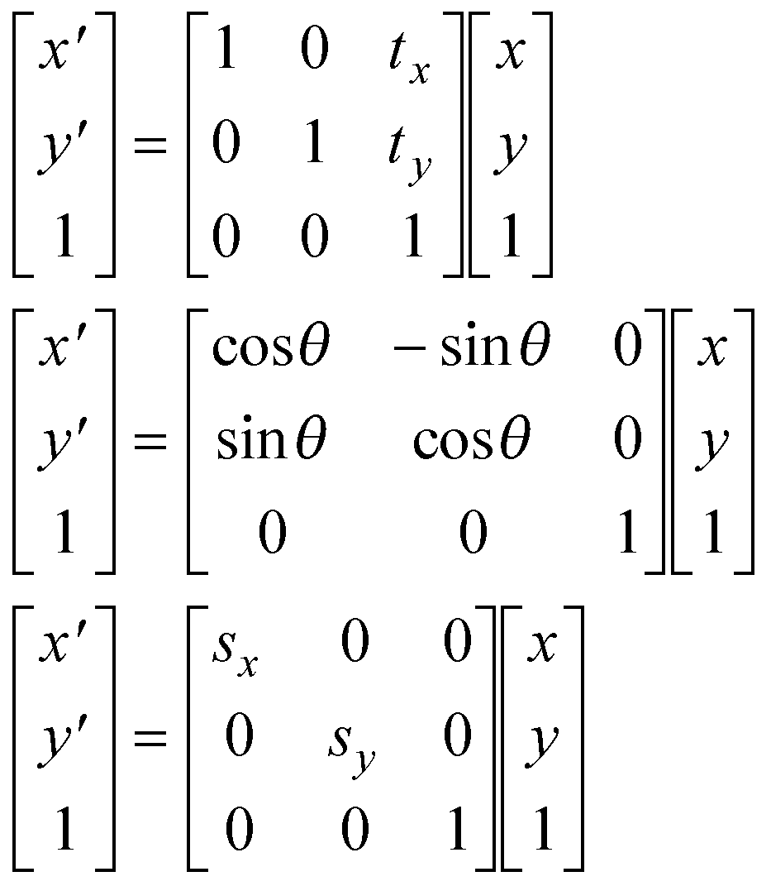
Homogeneous Coordinates
Basic Transformations
Translation
P’=TP
Rotation [O]
P’=RP
Scaling [O]
P’=SP

Slide 21
3D Transformations

Slide 22
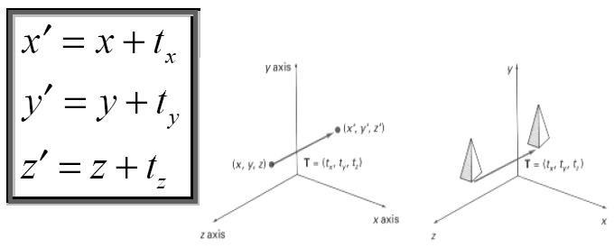
Translation

Slide 23
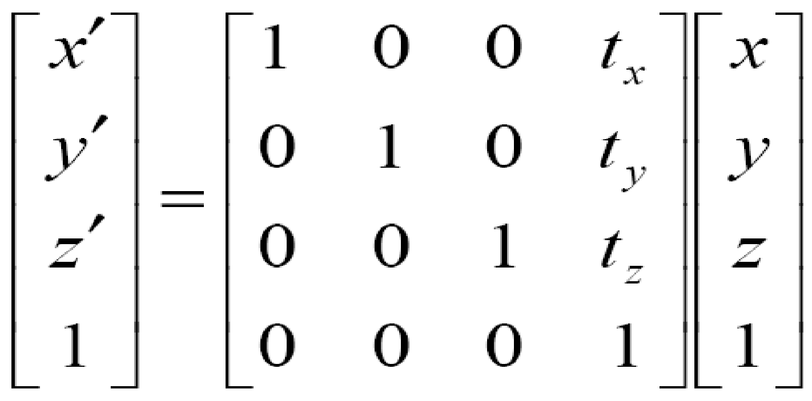
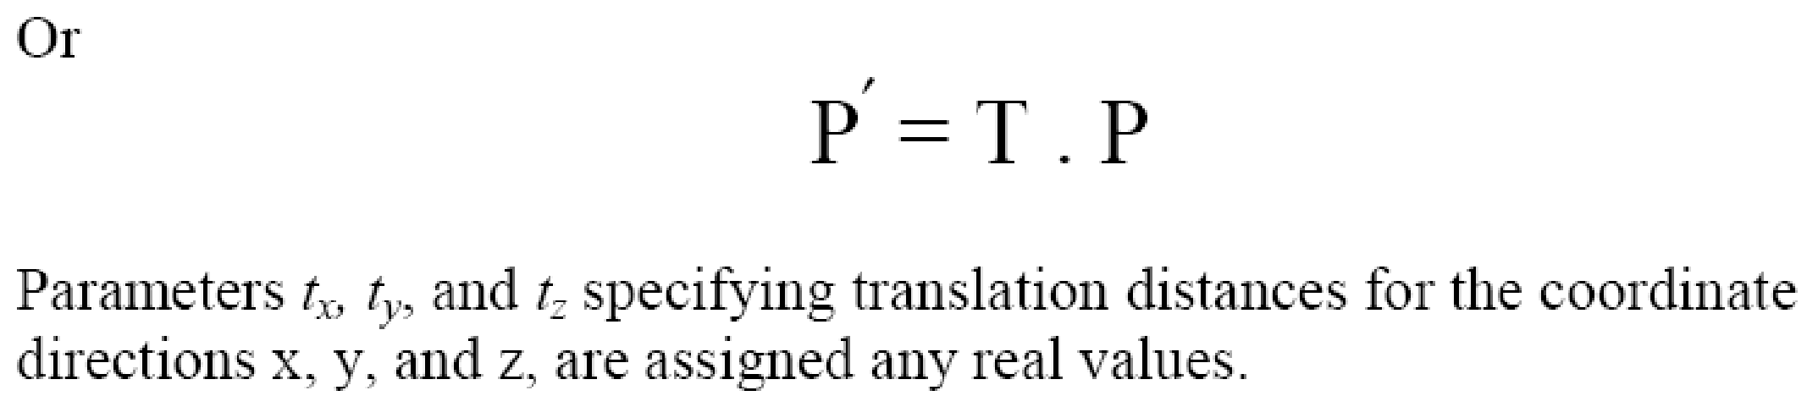
Translation

Slide 24
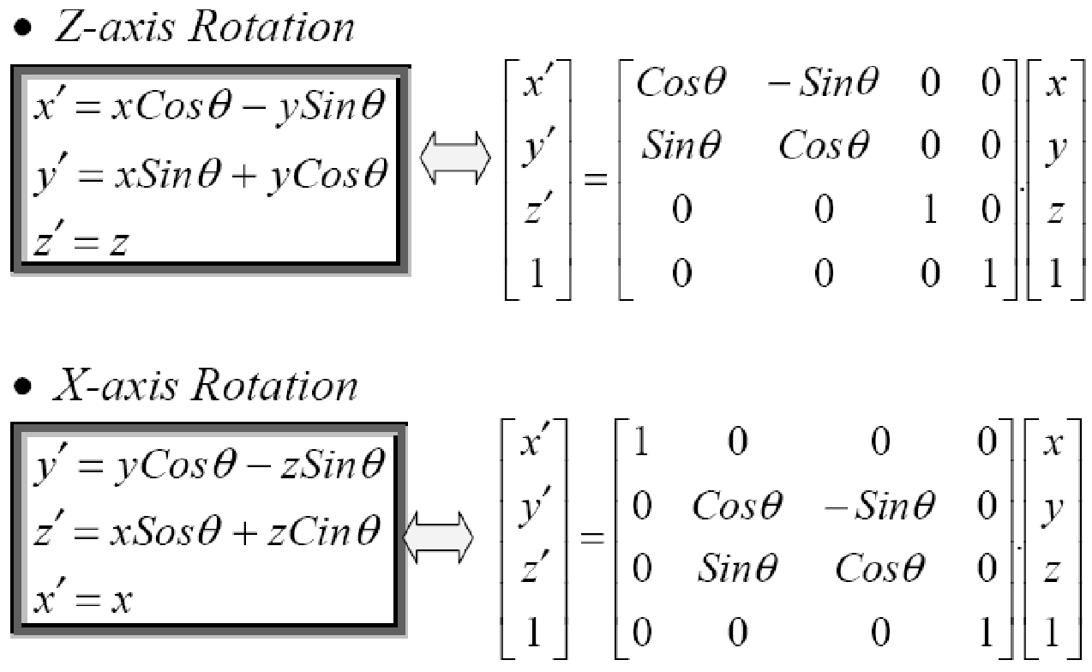
Rotation

Slide 25
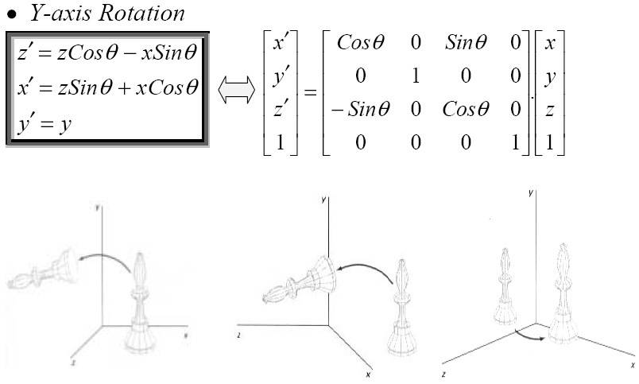
Rotation

Slide 26
Rotation
Parallel to one of the Coordinate Axis
In special cases where an object is to be rotated about an axis that is parallel to one of the coordinate axis, we can obtain the desired rotation with the following transformation sequence.
Translate the object so that the rotation axis coincides with the parallel coordinate axis (for simplicity, let us take x-axis).
Perform the specified rotation about that axis.
Translate the object so that the rotation axis is moved back to its original position.

Slide 27
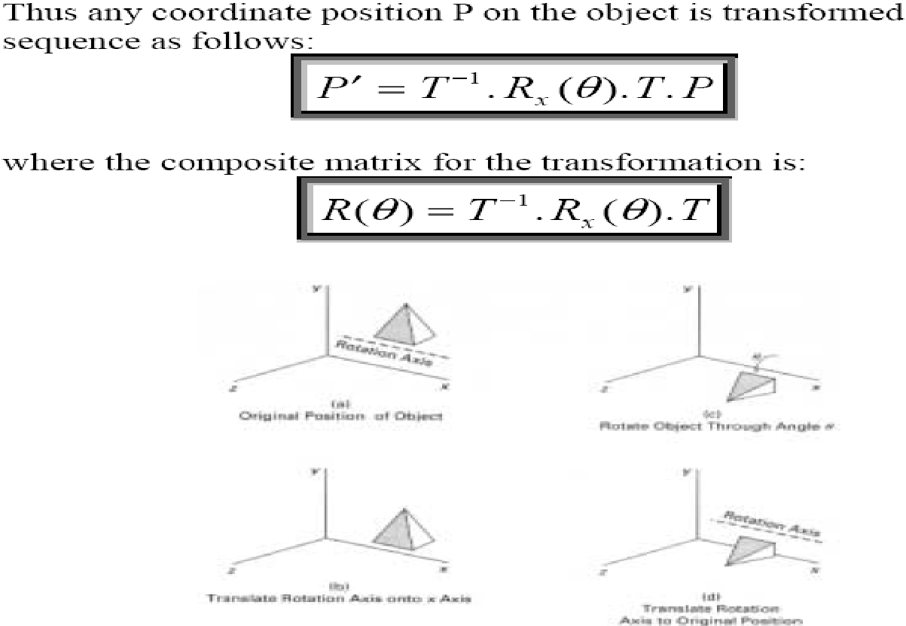
Rotation

Slide 28
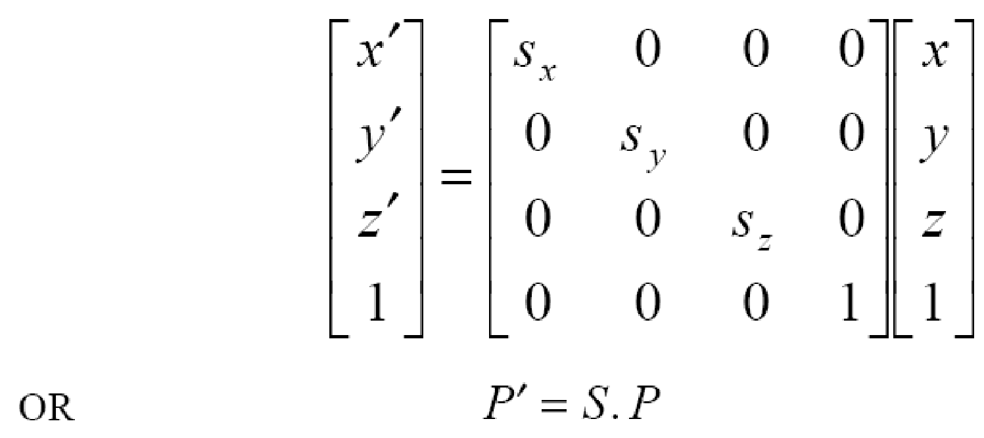
Scaling
The matrix expression for the scaling transformation of a position P = (x, y, z) relative to coordinate origin can be written as:

Slide 29
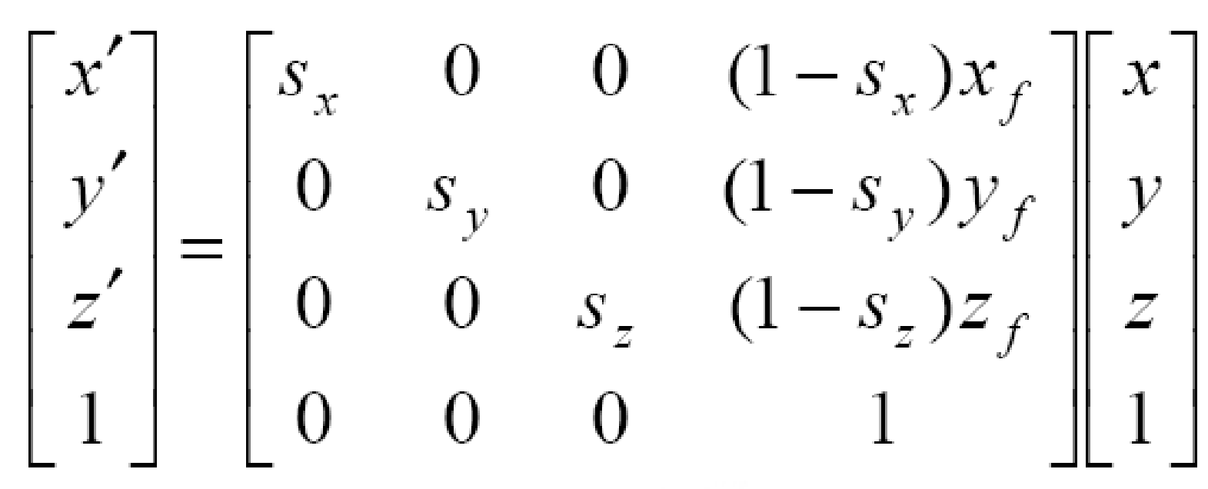
Scaling
The matrix representation for an arbitrary fixed-point (x_{f}, y_{f}, z_{f}) can be expressed as:

Slide 30
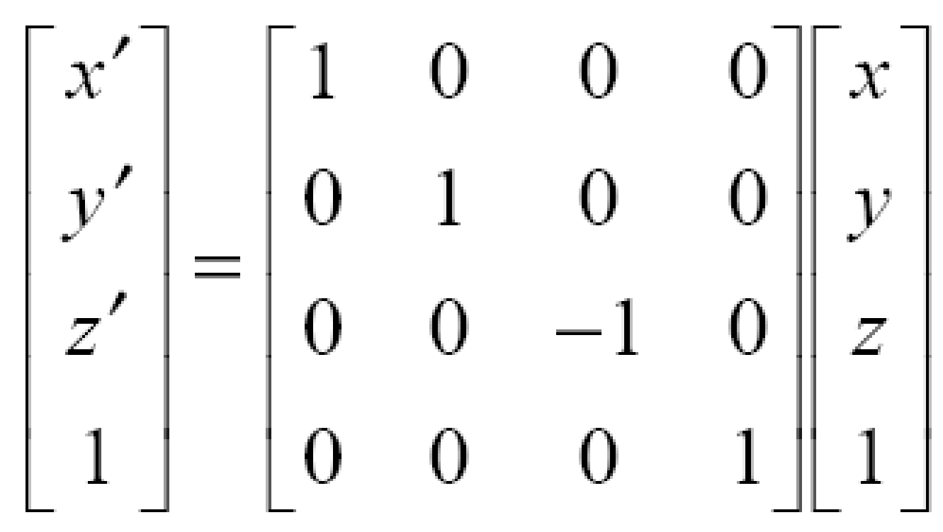
Reflections
The matrix expression for the reflection transformation of a position P = (x, y, z) relative to x-y plane can be written as:
Transformation matrices for inverting x and y values are defined similarly, as reflections relative to yz plane and xz plane, respectively.

Slide 31
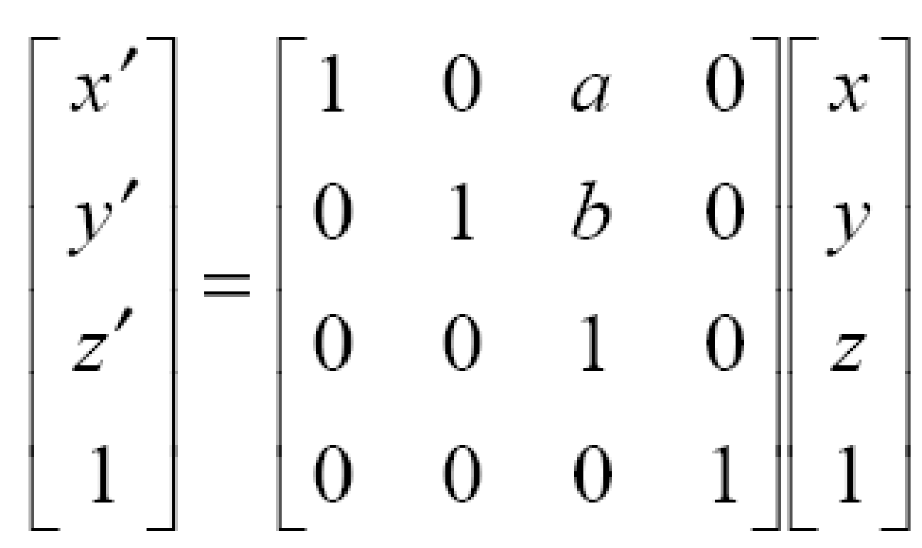
Shears
The matrix expression for the shearing transformation of a position P = (x, y, z), to produce z-axis shear, can be written as:

Slide 32
Shears
Parameters a and b can be assigned any real values. The effect of this transformation is to alter x- and y- coordinate values by an amount that is proportional to the z value, while leaving the z coordinate unchanged.
Shearing transformations for the x axis and y axis are defined similarly.

Slide 33
Q & A
1. A three dimensional graphics has
a. Two axes
b. Three axes
c. Both a & b
d. None of these
2. _________as the most commonly used boundary presentation for a 3-D graphics object
a. Data polygon
b. Surface polygon
c. System polygon
d. None of these
3.The most basic transformation that are applied in three-dimensional planes are
a. Translation
b. Scaling
c. Rotation
d. All of these

Slide 34
4.The transformation in which an object can be shifted to any coordinate position in three dimensional plane are called
a. Translation
b. Scaling
c. Rotation
d. All of these
5.The transformation in which the size of an object can be modified in x-direction ,y-direction and z-direction
a. Translation
b. Scaling
c. Rotation
d. All of these
6.In which transformation ,the mirror image of an object can be seen with respect to x-axis, y-axis ,z-axis as well as with respect to an arbitrary line
a. Reflection
b. Shearing
c. Translation
d. None of these

Slide 35
7.A three dimensional object can also be represented using_______
a. Method
b. Equation
c. Point
d. None of these

